Slide 1
Convolutional Neural Networks 3 Pavlos Protopapas

Slide 2
Convolutional Neural Networks III

Slide 3
Outline
Regularization for CNN
BackProp of MaxPooling layer
Layers Receptive Field and dilated convolutions
Weights and feature maps visualization

Slide 4
Outline
Regularization for CNN
BackProp of MaxPooling layer
Layers Receptive Field and dilated convolutions
Weights and feature maps visualization

Slide 5

Training CNNs
Backprop works the same way.
Remember you can think of a kernel as a single neuron.

Slide 6
Regularization for CNN
L2 and L1 work the same way as in FFNN
Data Augmentation is the same
Early Stopping same as in FFNN
Dropout is slightly different – not the same effect as dropout with FFNN.
Dropout in CNN still allows the weights in a kernel to be trained.
The name is misleading!
The effect of dropout on convolutional layers amounts to multiplying Bernoulli noise into the feature maps of the network.
So, if you try adding dropout after a convolutional layer and get bad results, don’t be disappointed! There doesn’t appear that there is a good reason it should provide good results.

Slide 7
Outline
Regularization for CNN
BackProp of MaxPooling layer
Layers Receptive Field and dilated convolutions
Weights and feature maps visualization

Slide 8
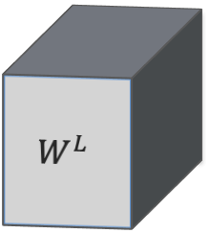
Backward propagation of Maximum Pooling Layer
Activation of layer L
2 | 4 | 8 | 3
9 | 3 | 4 | 2
5 | 4 | 6 | 3
2 | 3 | 1 | 3
$$W^{L}$$
rest of the network
rest of the network
MASK
Forward mode, 2x2 stride 2x2

Slide 9
Backward propagation of Maximum Pooling Layer
Activation of layer L
2 | 4 | 8 | 3
9 | 3 | 4 | 2
5 | 4 | 6 | 3
2 | 3 | 1 | 3
$$W^{L}$$
9
rest of the network
rest of the network
MASK
x
Forward mode, 2x2 stride 2x2

Slide 10
Backward propagation of Maximum Pooling Layer
Activation of layer L
2 | 4 | 8 | 3
9 | 3 | 4 | 2
5 | 4 | 6 | 3
2 | 3 | 1 | 3
$$W^{L}$$
9 | 8
rest of the network
rest of the network
MASK
 |  | x
x
Forward mode, 2x2 stride 2x2

Slide 11
Backward propagation of Maximum Pooling Layer
Activation of layer L
2 | 4 | 8 | 3
9 | 3 | 4 | 2
5 | 4 | 6 | 3
2 | 3 | 1 | 3
$$W^{L}$$
9 | 8
5
rest of the network
rest of the network
MASK
 |  | x
x
x
Forward mode, 2x2 stride 2x2

Slide 12
Backward propagation of Maximum Pooling Layer
Activation of layer L
2 | 4 | 8 | 3
9 | 3 | 4 | 2
5 | 4 | 6 | 3
2 | 3 | 1 | 3
$$W^{L}$$
9 | 8
5 | 6
rest of the network
rest of the network
MASK
 |  | x
x
x |  | x
Forward mode, 2x2 stride 2x2

Slide 13
Backward propagation of Maximum Pooling Layer
Activation of layer L
2 | 4 | 8 | 3
9 | 3 | 4 | 2
5 | 4 | 6 | 3
2 | 3 | 1 | 3
$$W^{L}$$
9 | 8
5 | 6
rest of the network
rest of the network
MASK
DERIVATIVES
 |  | x
x
x |  | x
1 | 2
2 | 5
Reverse mode

Slide 14
Backward propagation of Maximum Pooling Layer
Activation of layer L
2 | 4 | 8 | 3
9 | 3 | 4 | 2
5 | 4 | 6 | 3
2 | 3 | 1 | 3
$$W^{L}$$
9 | 8
5 | 6
rest of the network
rest of the network
MASK
DERIVATIVES
0 | 0
1 | 0
 |  | x
x
x |  | x
1 | 2
2 | 5
Reverse mode

Slide 15
Backward propagation of Maximum Pooling Layer
Activation of layer L
2 | 4 | 8 | 3
9 | 3 | 4 | 2
5 | 4 | 6 | 3
2 | 3 | 1 | 3
$$W^{L}$$
9 | 8
5 | 6
rest of the network
rest of the network
MASK
DERIVATIVES
0 | 0 | 2 | 0
1 | 0 | 0 | 0
 |  | x
x
x |  | x
1 | 2
2 | 5
Reverse mode

Slide 16
Backward propagation of Maximum Pooling Layer
Activation of layer L
2 | 4 | 8 | 3
9 | 3 | 4 | 2
5 | 4 | 6 | 3
2 | 3 | 1 | 3
$$W^{L}$$
9 | 8
5 | 6
rest of the network
rest of the network
MASK
DERIVATIVES
0 | 0 | 2 | 0
1 | 0 | 0 | 0
2 | 0
0 | 0
 |  | x
x
x |  | x
1 | 2
2 | 5
Reverse mode

Slide 17
Backward propagation of Maximum Pooling Layer
Activation of layer L
2 | 4 | 8 | 3
9 | 3 | 4 | 2
5 | 4 | 6 | 3
2 | 3 | 1 | 3
$$W^{L}$$
9 | 8
5 | 6
rest of the network
rest of the network
MASK
DERIVATIVES
0 | 0 | 2 | 0
1 | 0 | 0 | 0
2 | 0 | 5 | 0
0 | 0 | 0 | 0
 |  | x
x
x |  | x
1 | 2
2 | 5
Reverse mode

Slide 18
Backward propagation of Maximum Pooling Layer
Activation of layer L
2 | 4 | 8 | 3
9 | 3 | 4 | 2
5 | 4 | 6 | 3
2 | 3 | 1 | 3
$$W^{L}$$
9 | 8
5 | 6
rest of the network
rest of the network
MASK
DERIVATIVES
0 | 0 | 2 | 0
1 | 0 | 0 | 0
2 | 0 | 5 | 0
0 | 0 | 0 | 0
 |  | x
x
x |  | x
1 | 2
2 | 5
Reverse mode

Slide 19
Outline
Regularization for CNN
BackProp of MaxPooling layer
Layers Receptive Field and dilated convolutions
Weights and feature maps visualization

Slide 20
Layers Receptive Field
The receptive field is defined as the region in the input space that a particular CNN’s feature (or activation) is looking at (i.e. be affected by).
The receptive field size is a crucial issue in many visual tasks, as the output must respond to large enough areas in the image to capture information about large objects.

Slide 21


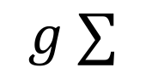

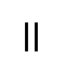


Layers Receptive Field
The receptive field is defined as the region in the input space that a particular CNN’s feature (or activation) is looking at (i.e. be affected by).
Let’s look at the receptive field in 1D, no padding, stride 1 and kernel 3x1
Activation map element
Layer 1
$$a_{1}^{1}$$
1D Kernel
$$=$$
$$W_{1}^{1}$$ | $$W_{2}^{1}$$ | $$W_{3}^{1}$$
$$g ∑$$
$$×$$
$$×$$
$$×$$
Input
activation

Slide 22
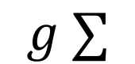

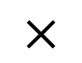

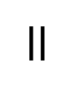
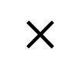
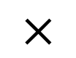
Layers Receptive Field
The receptive field is defined as the region in the input space that a particular CNN’s feature (or activation) is looking at (i.e. be affected by).
Let’s look at the receptive field in 1D, no padding, stride 1 and kernel 3x1
Layer 1
$$a_{1}^{1}$$
$$a_{2}^{1}$$
$$=$$
$$W_{1}^{1}$$ | $$W_{2}^{1}$$ | $$W_{3}^{1}$$
$$g ∑$$
$$×$$
$$×$$
$$×$$
Input

Slide 23

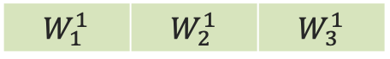



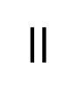


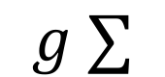
Layers Receptive Field
The receptive field is defined as the region in the input space that a particular CNN’s feature (or activation) is looking at (i.e. be affected by).
Let’s look at the receptive field in 1D, no padding, stride 1 and kernel 3x1
Layer 1
$$a_{1}^{1}$$
$$a_{2}^{1}$$
$$a_{3}^{1}$$
$$=$$
$$W_{1}^{1}$$ | $$W_{2}^{1}$$ | $$W_{3}^{1}$$
$$g ∑$$
$$×$$
$$×$$
$$×$$
Input

Slide 24



Layers Receptive Field
The receptive field is defined as the region in the input space that a particular CNN’s feature (or activation) is looking at (i.e. be affected by).
Let’s look at the receptive field in 1D, no padding, stride 1 and kernel 3x1
Layer 1
$$a_{1}^{1}$$
$$a_{2}^{1}$$
$$a_{3}^{1}$$
Input

Slide 25
Layers Receptive Field
The receptive field is defined as the region in the input space that a particular CNN’s feature (or activation) is looking at (i.e. be affected by).
Let’s look at the receptive field in 1D, no padding, stride 1 and kernel 3x1
Layer 2
Layer 1
Input

Slide 26
Layers Receptive Field
The receptive field for each element of layer’s 2 is shown below.
Layer 2
Layer 1
Input

Slide 27
Layers Receptive Field
The receptive field for each element of layer’s 2 is shown below.
Layer 2
Layer 1
Input

Slide 28
Layers Receptive Field
The receptive field for each element of layer’s 2 is shown below.
Layer 2
Layer 1
Input

Slide 29
Layers Receptive Field
The receptive field for each element of layers 1 and 2 are shown below.
Layer 2
Layer 1
Input

Slide 30
Layers Receptive Field
The receptive field for each element of layers 1 and 2 are shown below.
Layer 2
Layer 1
Input

Slide 31
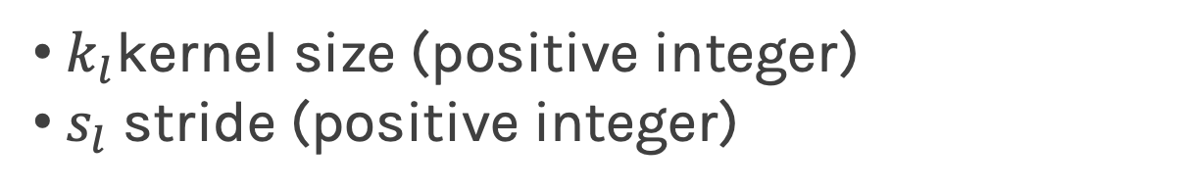
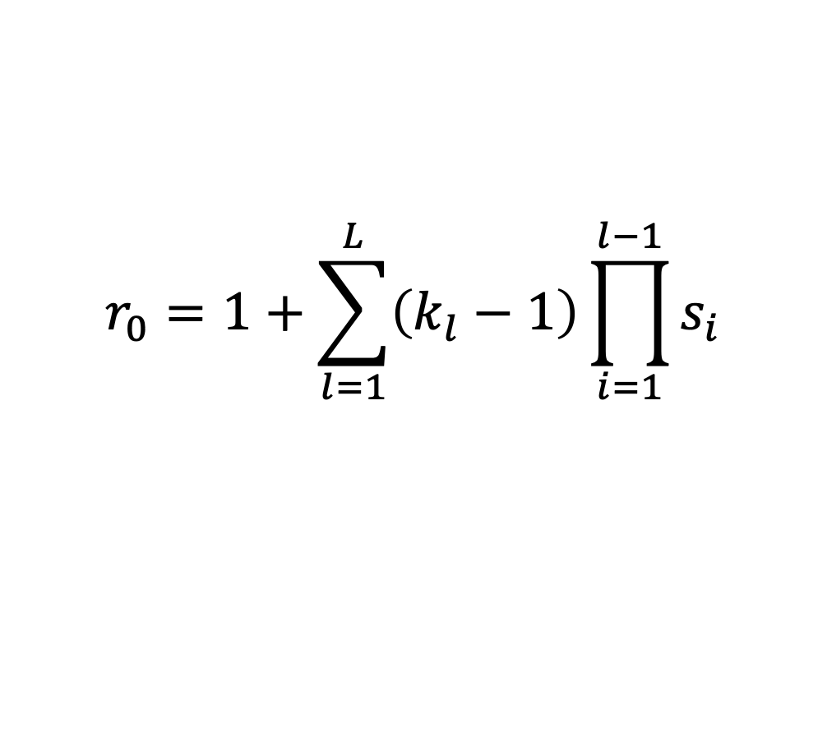
Layers Receptive Field
In 2D, it works the same way.
The receptive field can be calculated using the recursive formula:
$$r_{0}=1+\sum_{l=1}^{L}{\left(k_{l}−1\right)\prod_{i=1}^{l−1}{s_{i}}}$$
$k_{l}$kernel size (positive integer)
$s_{l}$ stride (positive integer)

Slide 32
Dilated CNNs
We can “inflate” the receptive field by inserting holes between the kernel elements.
These are called Dilated Convolutions.
Dilation rate indicates how much the kernel is widened.
Dilate rate=1
Original Idea: Algorithme a trous, an algorithm for wavelet decomposition (Holschneider et al., 1987; Shensa, 1992)

Slide 33
Dilated CNNs
We can “inflate” the receptive field by inserting holes between the kernel elements.
These are called Dilated Convolutions.
Dilation rate indicates how much the kernel is widened.
Dilate rate=1

Slide 34
Dilated CNNs
We can “inflate” the receptive field by inserting holes between the kernel elements.
These are called Dilated Convolutions.
Dilation rate indicates how much the kernel is widened.
Dilate rate=1

Slide 35
Dilated CNNs
We can “inflate” the receptive field by inserting holes between the kernel elements.
These are called Dilated Convolutions.
Dilation rate indicates how much the kernel is widened.
Dilate rate=1

Slide 36
Dilated CNNs
2D Example: 2x2 kernel, stride=1, dilate rate=1

Slide 37
Dilated CNNs
There is a relationship between classification accuracy and receptive field size.
Large receptive fields are necessary for high-level recognition tasks, but with diminishing rewards.
Araujo, A., Norris, W., & Sim, J. (2019). Computing receptive fields of convolutional neural networks. Distill, 4(11), e21.

Slide 38
Outline
Regularization for CNN
BackProp of MaxPooling layer
Layers Receptive Field
Weights and feature maps visualization

Slide 39
Lessons for Visualization
Choosing/designing machine learning visualization requires that we think about:
are we visualizing to diagnose problems with our models?
are we visualizing to interpret our model's meaningfulness?
do we visualize decision boundaries, weights of our model, and or distributional differences in the data?
Why and for whom to visualize?
What and how to visualize?

Slide 40
Why and for whom to visualize?
Interpretability & Explainability: understand how deep learning models make decisions and what representations they have learned.
Debugging & Improving Models: help model developers build and debug their models, with the hope of expediting the iterative experimentation process to ultimately improve performance.
Teaching Deep Learning Concepts: educate non-expert users about AI.
From: Visual Analytics in Deep Learning: An Interrogative Survey for the Next Frontiers
For others
For us
For me

Slide 41
What and how to visualize?
What technical components of neural networks could be visualized?
Computational Graph & Network Architecture
Learned Model Parameters: weights, filters
Individual Computational Units: activations, gradients
Aggregate information: performance metrics
How can they be insightfully visualized?
How depends on the type of data and model as well as our specific investigative goal.

Slide 42
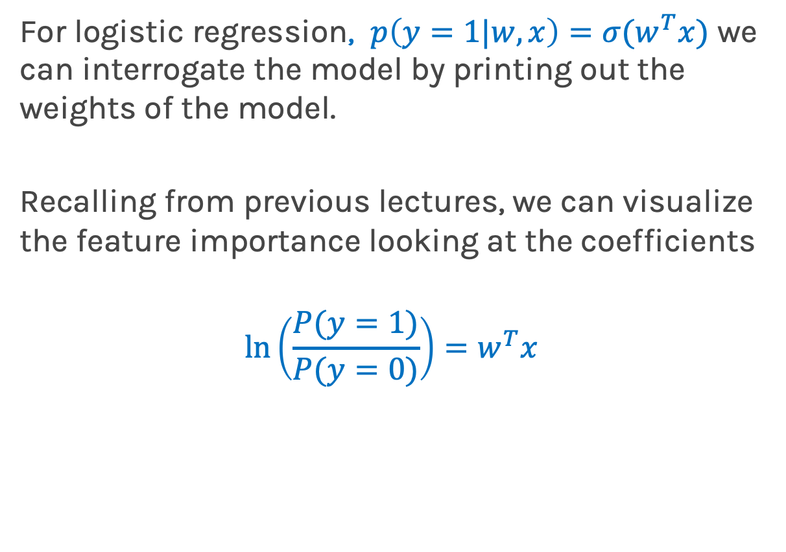
What to Visualize for Neural Network Models?
For logistic regression, $p\left(y=1|w,x\right)=σ(w^{T}x)$ we can interrogate the model by printing out the weights of the model.
Recalling from previous lectures, we can visualize the feature importance looking at the coefficients
$$\ln\left(\frac{P(y=1)}{P(y=0)}\right)=w^{T}x$$
log-odds

Slide 43
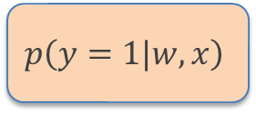
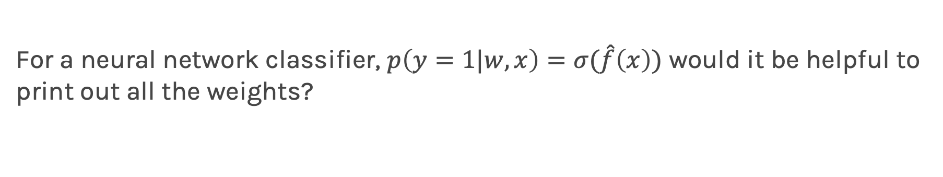
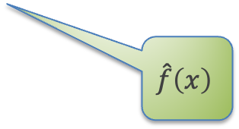
What to Visualize for Neural Network Models?
For a neural network classifier, $p\left(y=1|w,x\right)=σ(\hat{f}\left(x\right))$ would it be helpful to print out all the weights?
HIDDEN LAYERS
OUTPUT LAYER
$$p\left(y=1|w,x\right)$$
INPUT
$$\hat{f}\left(x\right)$$

Slide 44
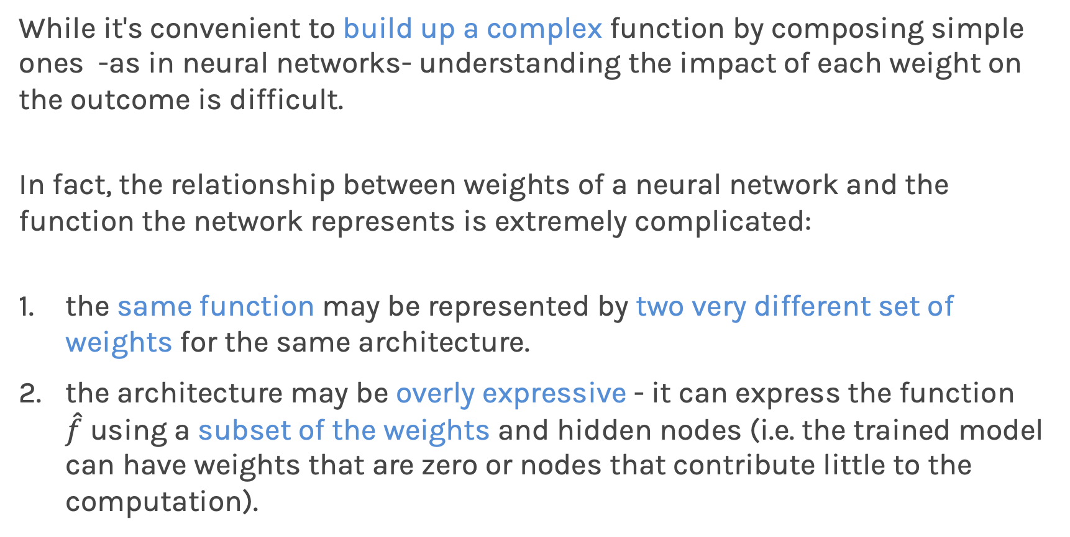
Weight Space Versus Function Space
While it's convenient to build up a complex function by composing simple ones -as in neural networks- understanding the impact of each weight on the outcome is difficult.
In fact, the relationship between weights of a neural network and the function the network represents is extremely complicated:
the same function may be represented by two very different set of weights for the same architecture.
the architecture may be overly expressive - it can express the function $\hat{f}$ using a subset of the weights and hidden nodes (i.e. the trained model can have weights that are zero or nodes that contribute little to the computation).

Slide 45
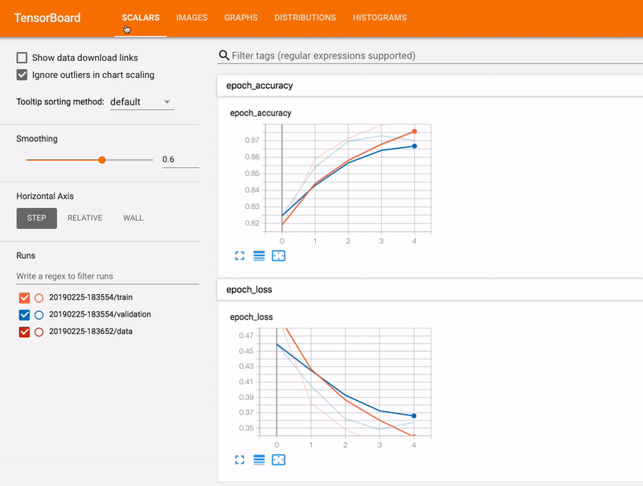
Debugging & Improving Models : Tensorboard
What happens if we want to know the outputs of a specific hidden layer?
By visualizing the network weights and activations as we train, we can diagnose issues that ultimately impact model performance.
TensorFlow provides a functionality to explore the inner workings of the network.
From: Tensorboard

Slide 46
Debugging & Improving Models : Tensorboard
By visualizing the network weights and activations as we train, we can diagnose issues that ultimately impact model performance.
The following visualizes the distribution of activations in two hidden layers over the course of training. What problems do we see?
From: Tensorboard

Slide 47
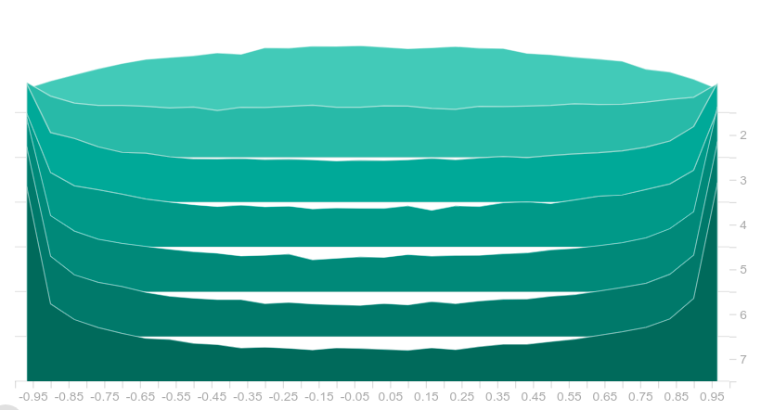
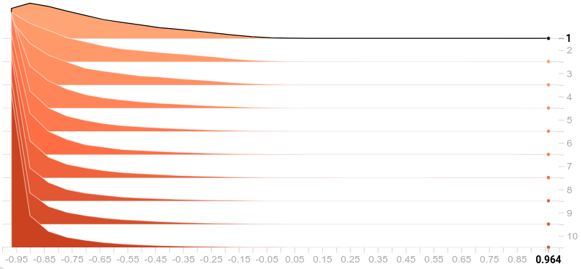
Debugging & Improving Models : Tensorboard
The following visualizes the distribution of activations in two hidden layers over the course of training.
What problems do we see?
epochs
Tanh activation
Tanh activation
From: Tensorboard

Slide 48
Debugging & Improving Models : Tensorboard
The following visualizes the distribution of activations in two hidden layers over the course of training.
The activations are starting to saturate, reducing the learning speed.
Tanh activation
Sigmoid activation
From: Tensorboard

Slide 49
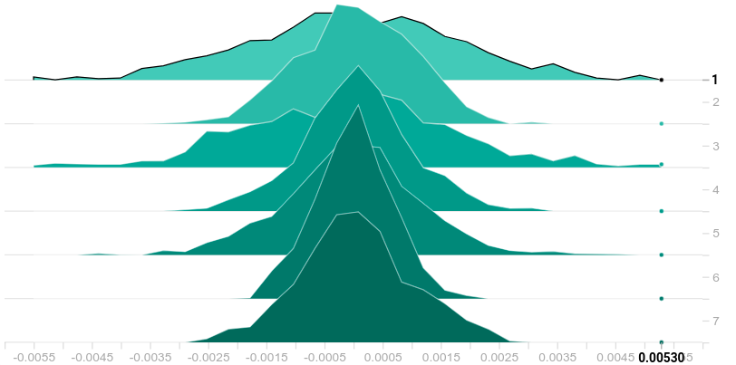
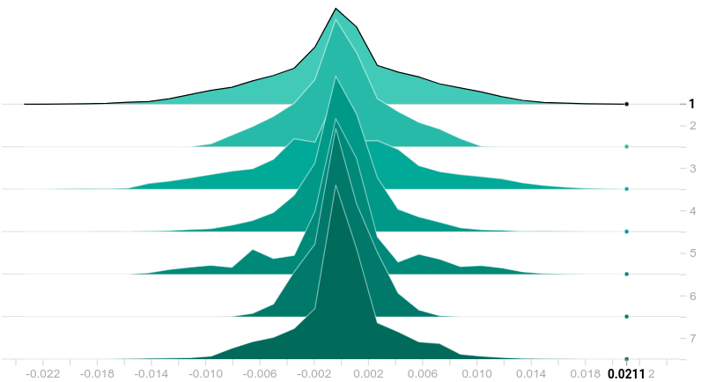
Debugging & Improving Models : Tensorboard
The following visualizes the distribution of gradients in two hidden layers over the course of training.
What problems do we see?
From: Tensorboard

Slide 50
Debugging & Improving Models : Tensorboard
The following visualizes the distribution of gradients in two hidden layers over the course of training.
In both layers, the gradients start to became zero. Smaller gradients imply smaller weight updates and slow training speed.
From: Tensorboard

Slide 51
CNN Feature Extraction Visualization
We know that CNNs extract features that best helps us to perform our downstream task (e.g. classification).
Idea: We train a CNN for feature extraction and a model (e.g. MLP, decision tree, logistic regression) for classification, simultaneously and end-to-end.

Slide 52
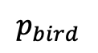
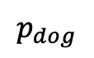
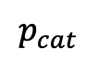
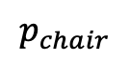
CNN Feature Extraction Visualization
We know that CNNs extract features that best helps us to perform our downstream task (e.g. classification).
Idea: We train a CNN for feature extraction and a model (e.g. MLP, decision tree, logistic regression) for classification, simultaneously and end-to-end.
The resulting feature maps are matrices, that we can interpret as images. As such, we can analyze them a look for relevant patterns.
BIRD
$$p_{bird}$$
CHAIR
$$p_{chair}$$
CAT
$$p_{cat}$$
DOG
$$p_{dog}$$
Convolution + Nonlinearity
Max Pooling
CONVOLUTION + POOLING LAYERS
FULLY CONNECTED LAYERS

Slide 53
What to Visualize for CNNs?
The first things to try are:
visualize the result of applying a learned filter to an image
visualize the filters themselves
Input image
HARD TO UNDERSTAND OR INTERPRETATE
Feature maps
Kernels

Slide 54
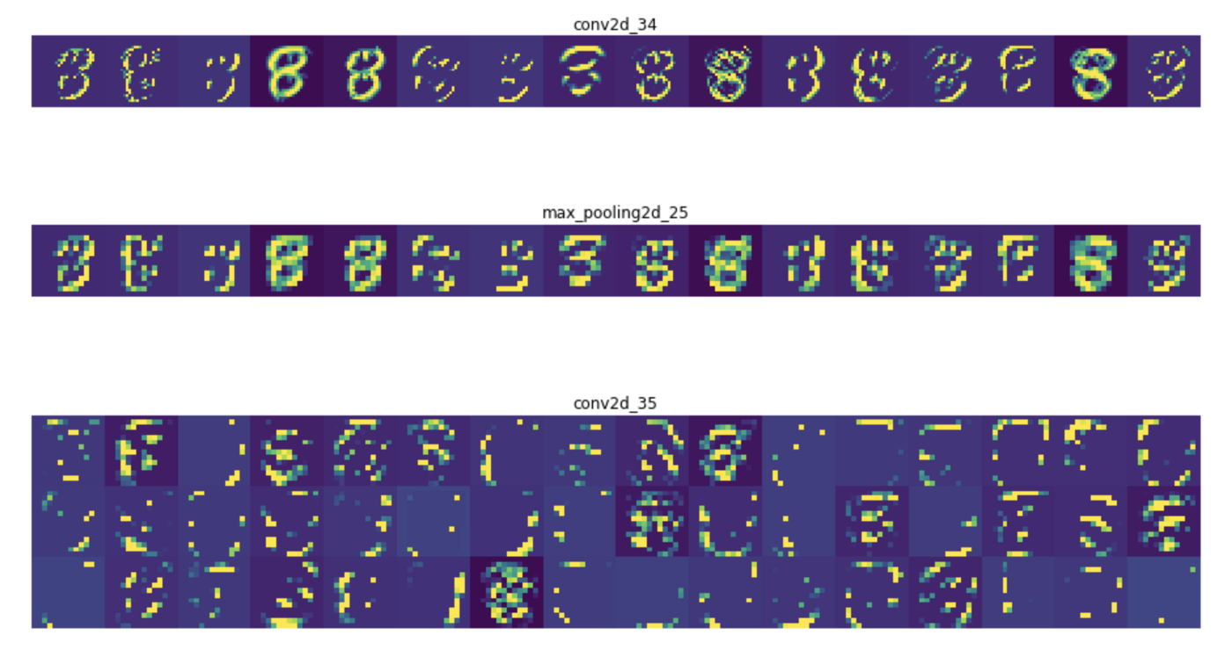
Occlusion methods
If we want to interpret what part of the image the network is paying more attention, these visualizations might not be the best solution.
We have no guarantees that the feature maps will provide meaningful information. Their interpretation can be even more difficult than the original problem.
Activations maps for layer1
Activations maps for layer2

Slide 55
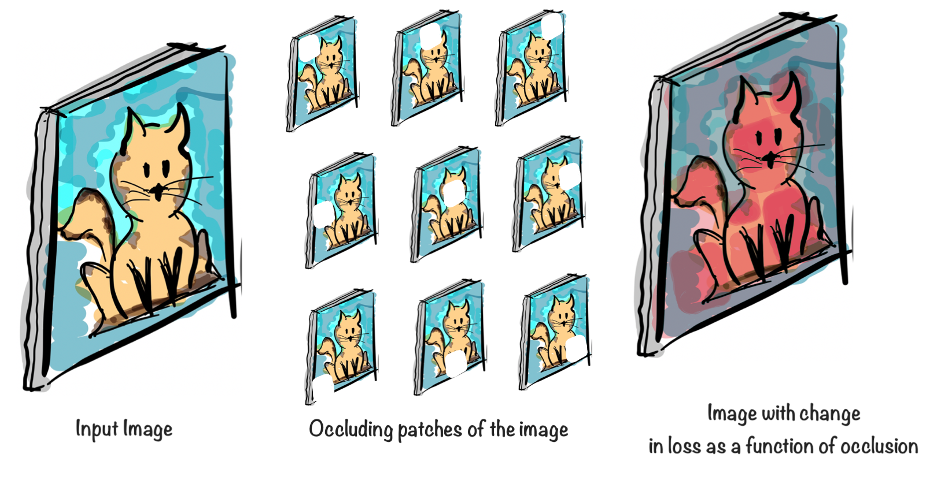
Occlusion methods
Occlusion methods attributes importance for the classification of the image. Occlusion involves running a patch over part of the image to see which pixels affect the classification the most.

Slide 56
Occlusion methods
Occlusion methods attributes importance for the classification of the image. Occlusion involves running a patch over part of the image to see which pixels affect the classification the most.

Slide 57
Occlusion methods
Occlusion methods attributes importance for the classification of the image. Occlusion involves running a patch over part of the image to see which pixels affect the classification the most.

Slide 58
Occlusion methods
However, to obtain fine details we need to use a small occlusion area, increasing the number of model evaluations. This can become impractical for a fine resolution and many test images.

Slide 59
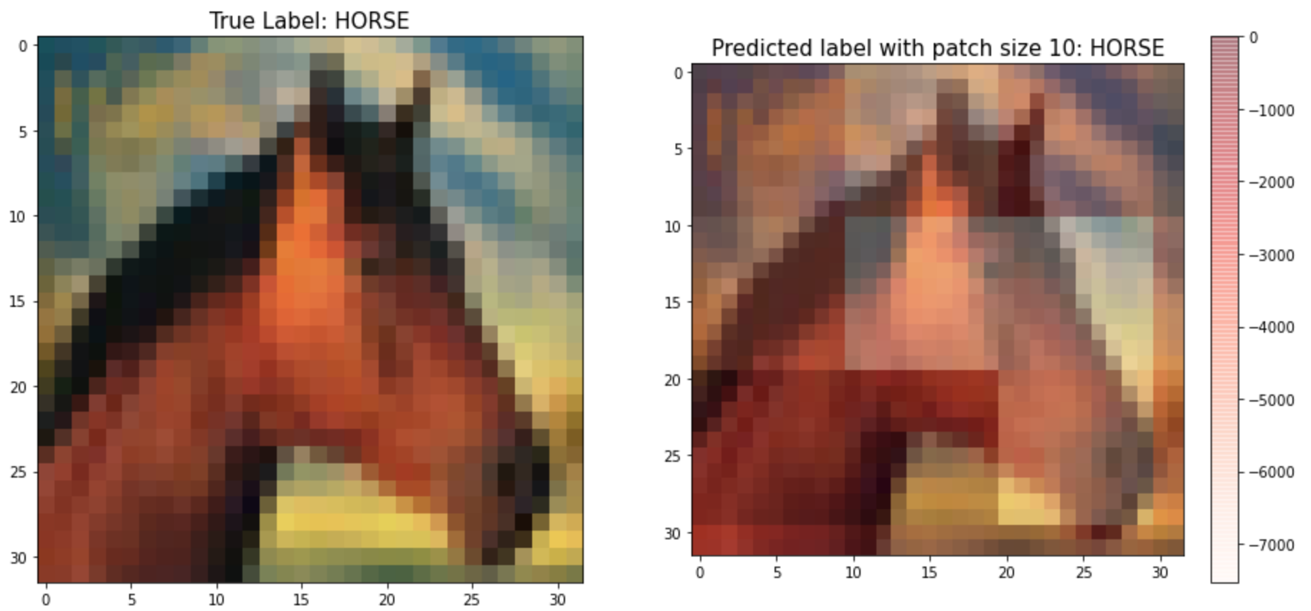
Exercise: Image Occlusion
The aim of this exercise is to understand occlusion. Occlusion involves running a patch over the entire image to see which pixels affect the classification the most.

Slide 60
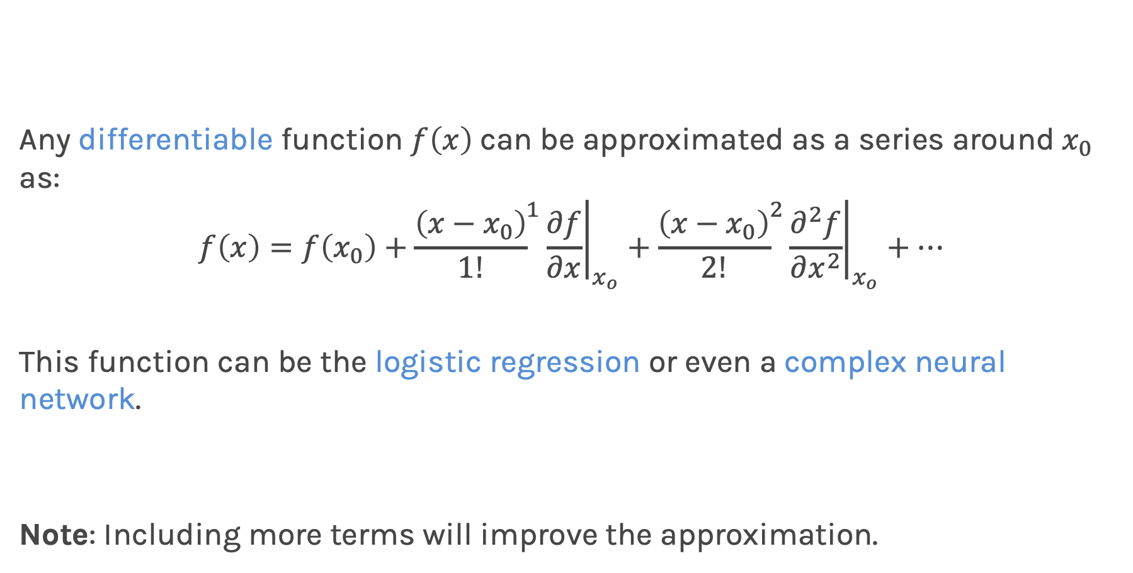
Taylor series expansion
Any differentiable function $f\left(x\right)$can be approximated as a series around$x_{0}$ as:
$$f\left(x\right)={\left.f\left(x_{0}\right)+{\frac{\left(x−x_{0}\right)}{1!}}^{1}\frac{∂f}{∂x}\right|}_{x_{o}}+{\left.{\frac{\left(x−x_{0}\right)}{2!}}^{2}\frac{∂^{2}f}{∂x^{2}}\right|}_{x_{o}}+…$$
This function can be the logistic regression or even a complex neural network.
Note: Including more terms will improve the approximation.

Slide 61
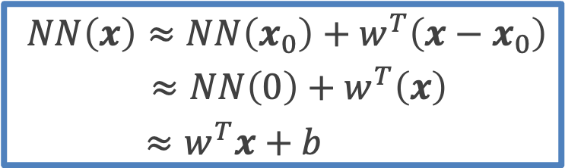
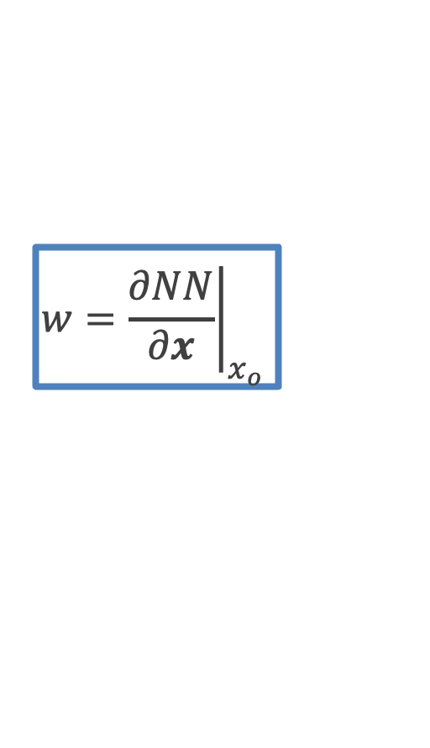
Visualizing Top Predictors by Input Gradient
Since the input gradient of an objective function for a trained model indicates which input dimensions has the greatest effect on the model decision at an input 𝐱, we can visualize the "top predictors" of outcome for a particular input 𝐱.
We can think of this as approximating our neural network model with a linear model locally at an input 𝐱 and then interpreting the weights of this linear approximation.
$$NN\left(x\right)≈NN\left(x_{0}\right)+w^{T}\left(x−x_{0}\right)$$
$≈NN\left(0\right)+w^{T}\left(x\right)$
$≈w^{T}x+b$
$$w={\left.\frac{∂NN}{∂x}\right|}_{x_{o} }$$

Slide 62
Thank you

